Slide 1

Tour of PowerBI Desktop

Slide 2
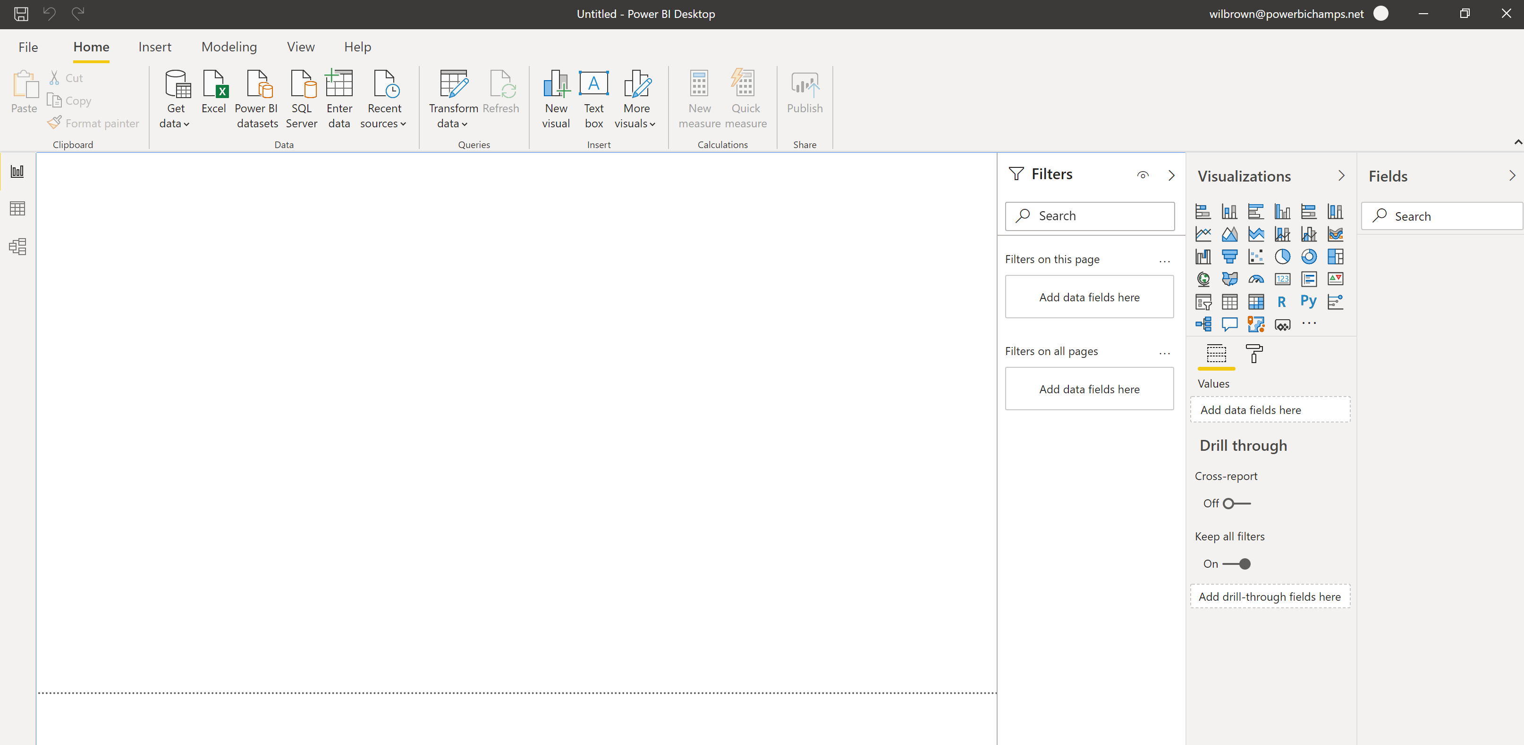
The Basic Desktop
Ribbon Option
Ribbon - most functions there and can change depending on context or option selected
Views: Toggles between report, data and model.
Visual Well
Layout Well
Field Well
Filter Well – on report pane

Slide 3
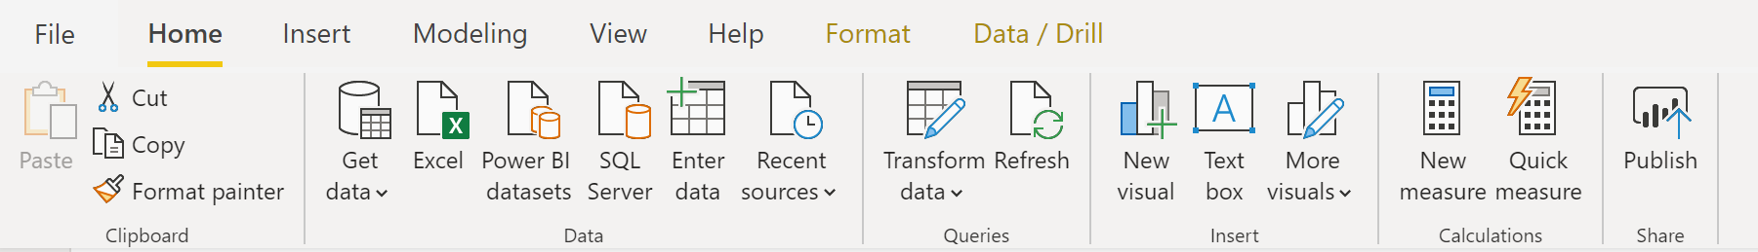
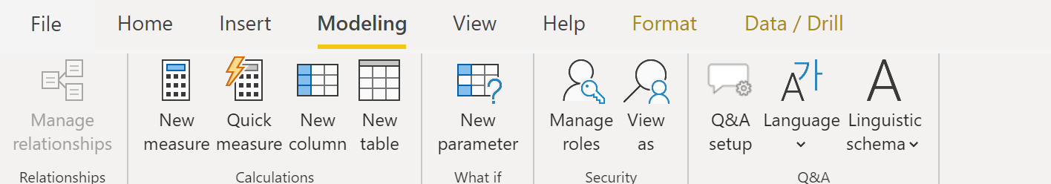
Ribbon – most important ribbons and actions
Home Ribbon
Get data from all sources
Open Power Query
Add measure
Publish to Service
Modeling Ribbon
Add measure and columns
Row Level Security

Slide 4
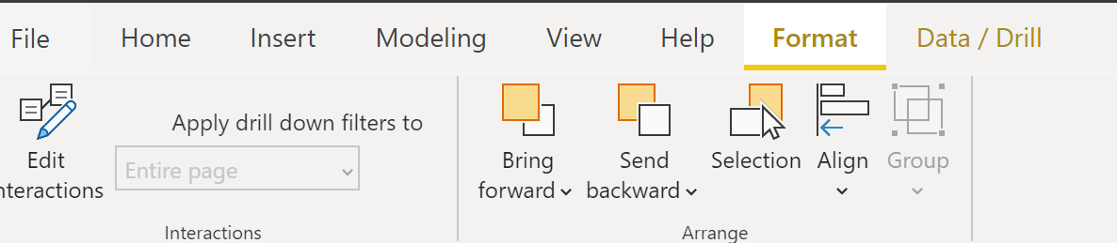
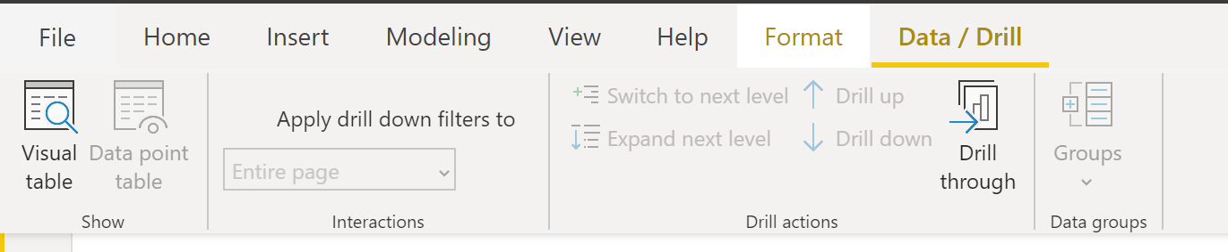
Ribbon – menus when visual is selected
Format Ribbon
Edit interactions between visuals
Data/Drill Ribbon

Slide 5
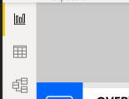
Views
Report / Visualizations
Data View
Model View

Slide 6
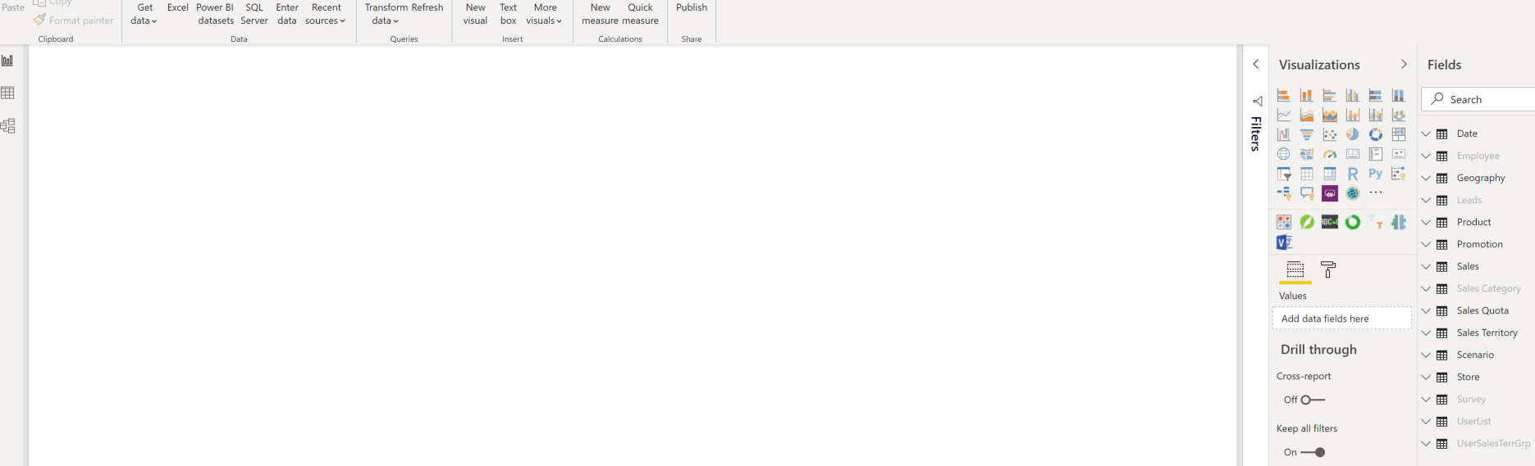
Report View
View used to create report- select visuals, add data and setup the overall look and feel

Slide 7
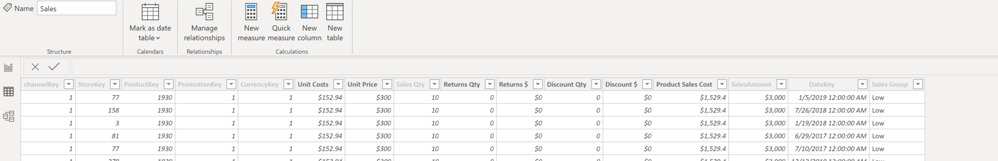
Data View
View to examine base data, add calculations, and review data types

Slide 8
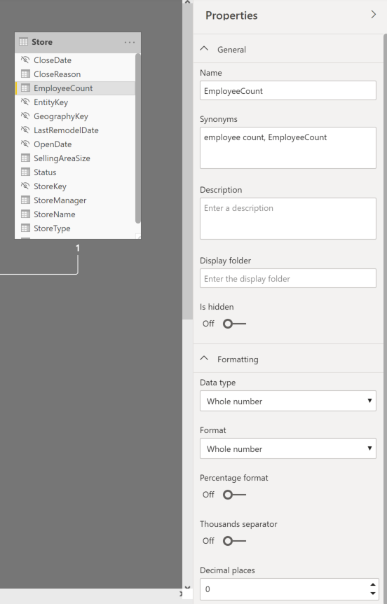
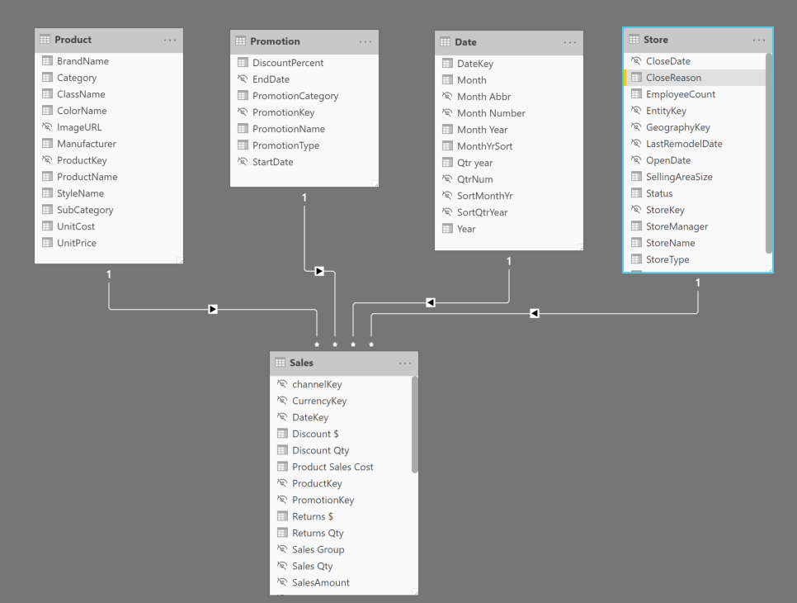
Model View
Or set attributes of the data, rename fields, change data types
View to see and create relationships between tables

Slide 9
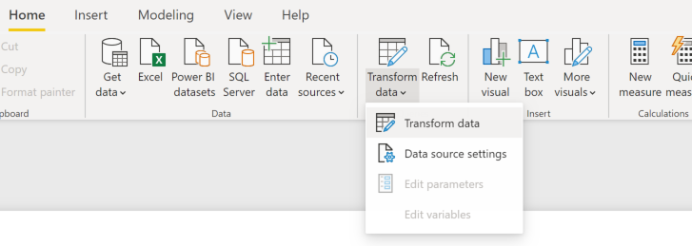
Power Query
Power Query is the data transformation tool for PBI – if data is not prefect then Power Query allows users to create a series of steps to prepare the data. The Get Data Button launches Power Query as well.
Power Query has a number of ribbons all around data prep. The steps applied to the data are stored in a recipe that is applied every time data is loaded.

Slide 10
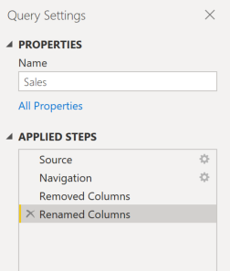
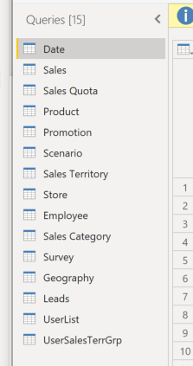
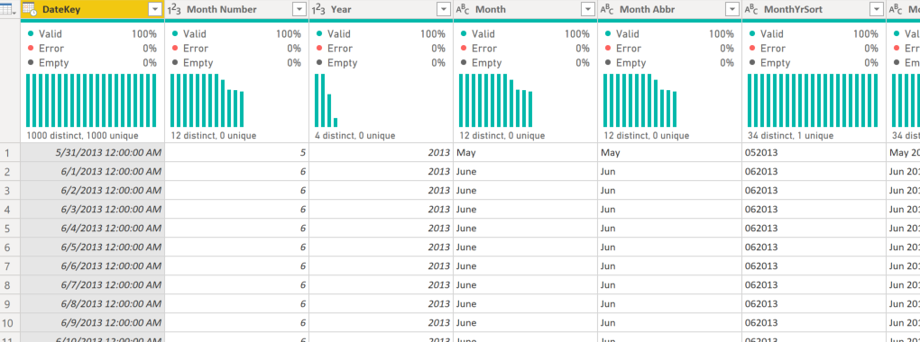
Power Query
Home Ribbon
One query of data with data profiling enabled
Query steps – can be added to, reordered or steps deleted
Queries or tables of data

